Slide 1
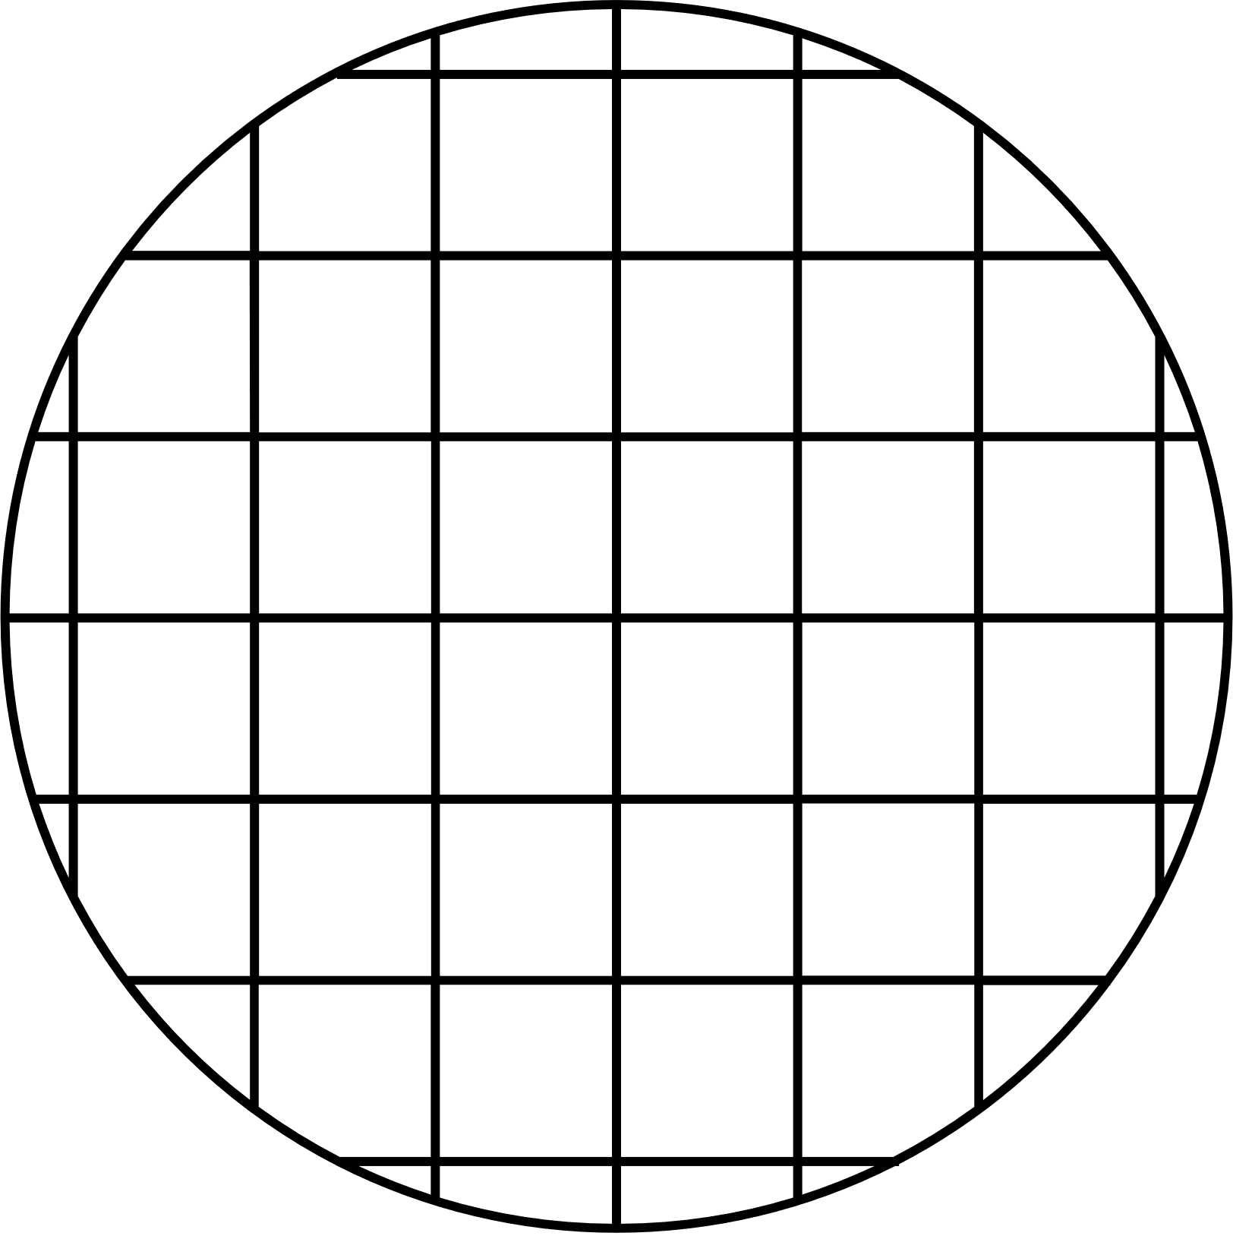


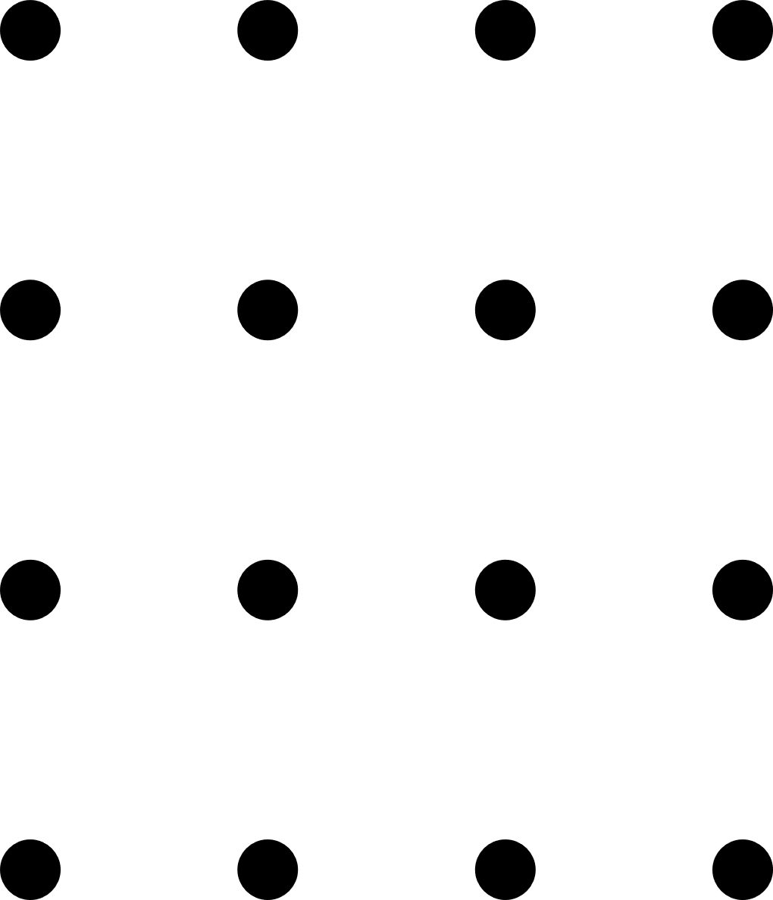
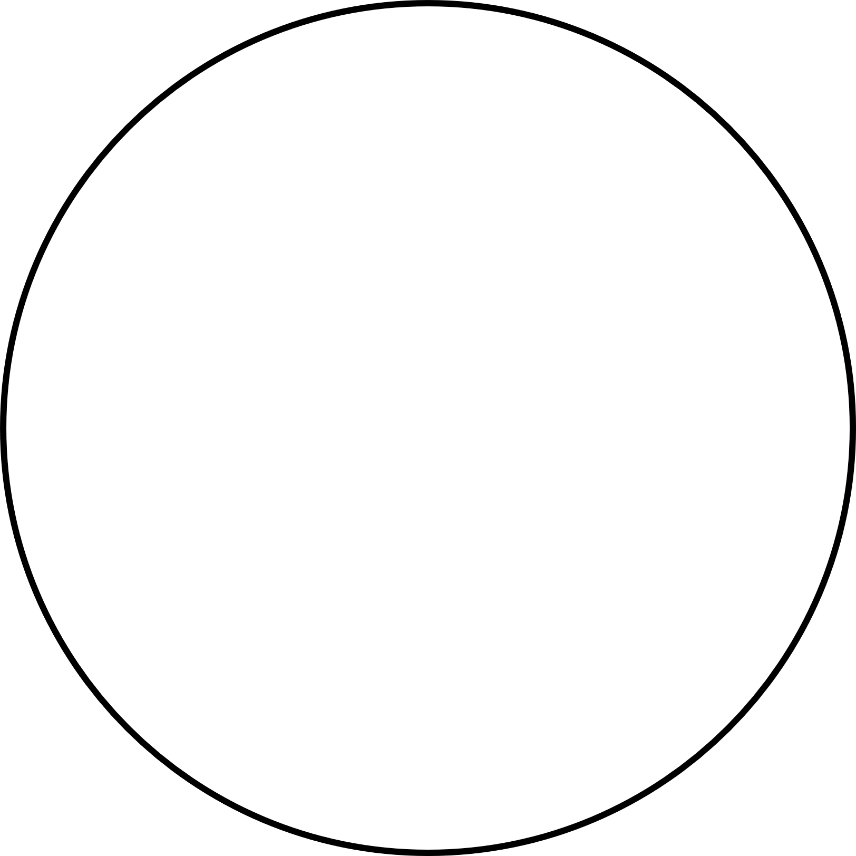
Let's Start
Genetic
Algorithm

Slide 2
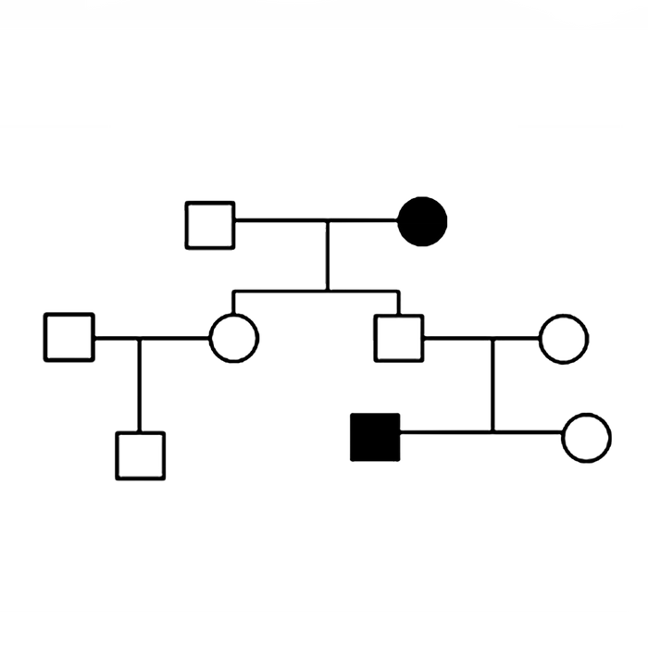
This algorithm reflects the process of natural selection where the fittest individuals are selected for reproduction in order to produce offspring of the next generation.
What is a
Genetic Algorithm

Slide 3
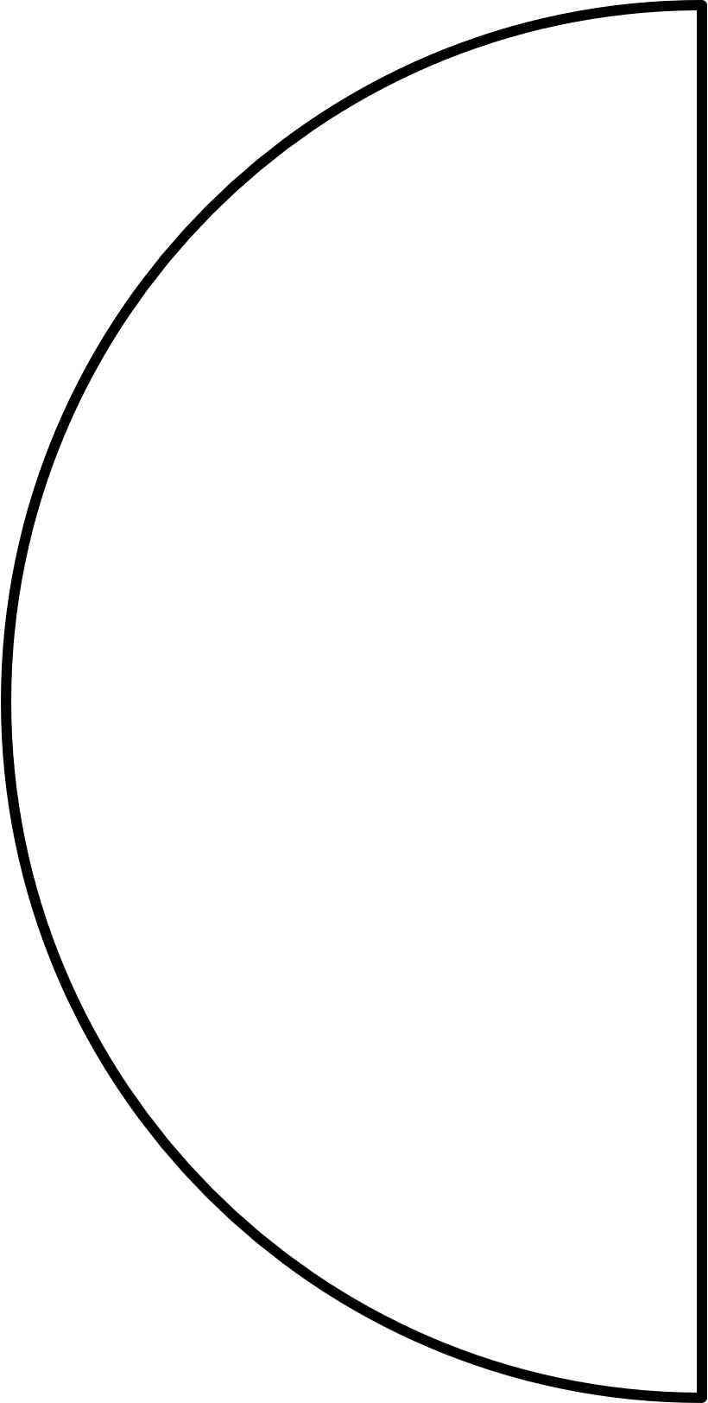






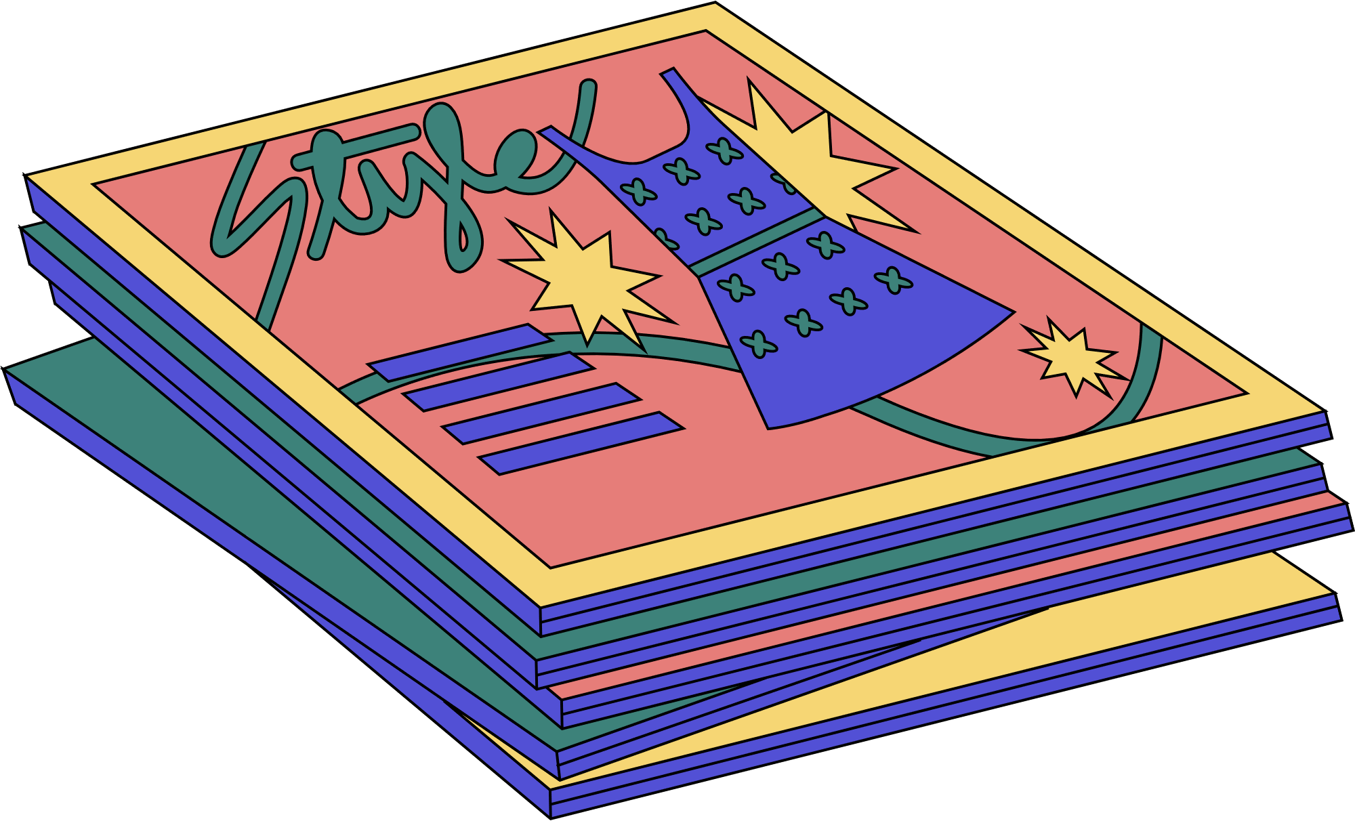

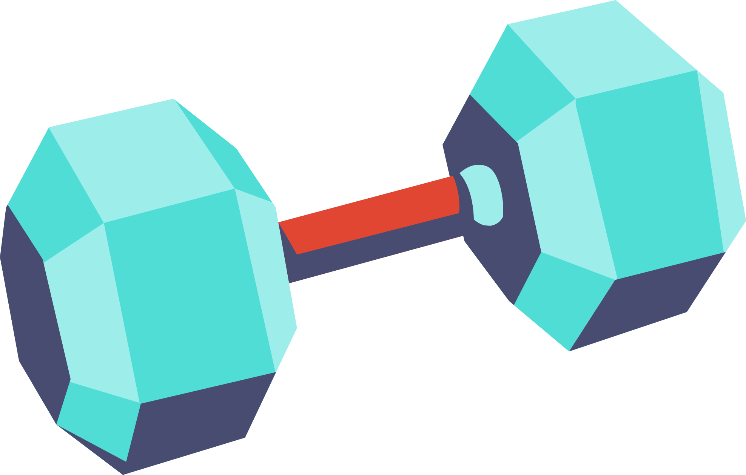

Knapsack problem
3000
800
100
150
900
1700
950
50
600
550
600
250
1600
150
300
[1]
[1]
[0]
[1]
[0]
[0]
[1]

Slide 4
n items
n
2
Have different combinations

Slide 5
20 items
for PC
~ 1 sec
Will have 1,048,576 different combinations

Slide 6
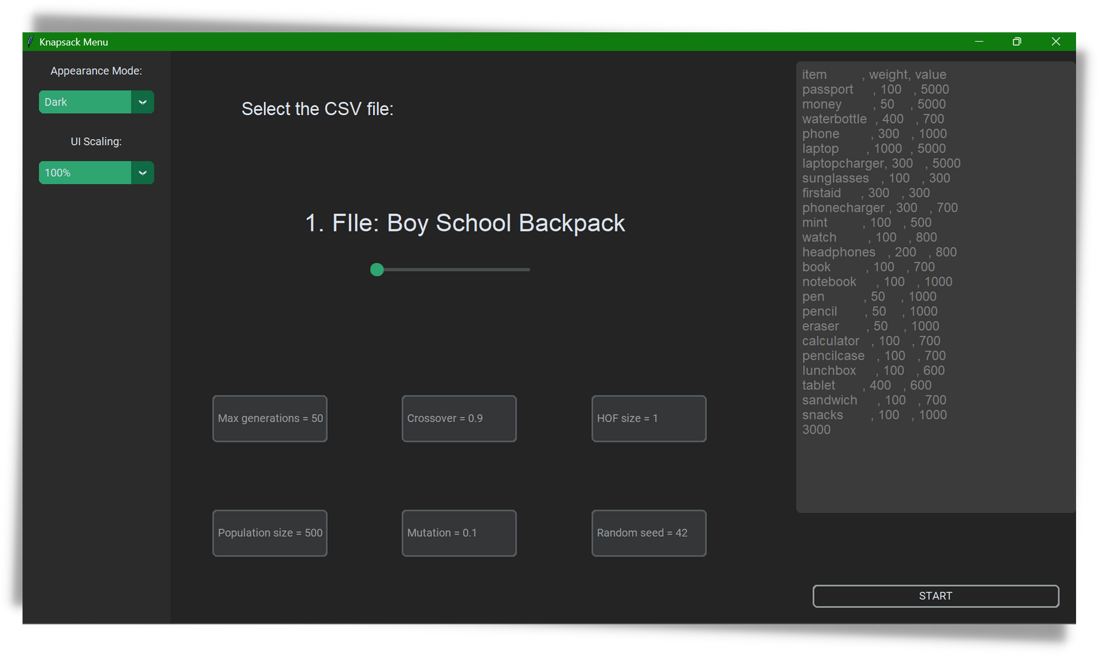
Program Interface

Slide 7
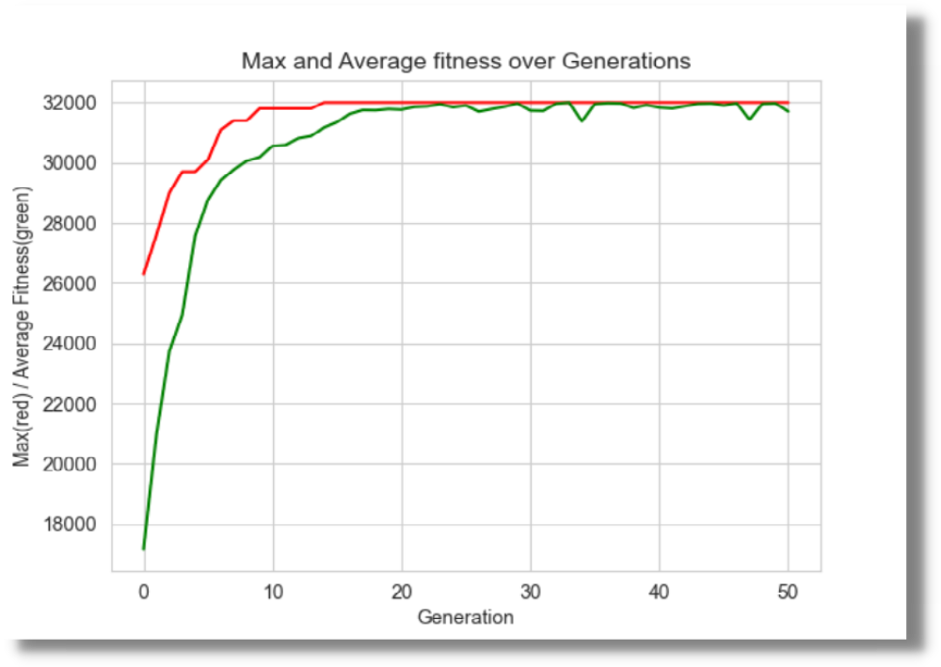
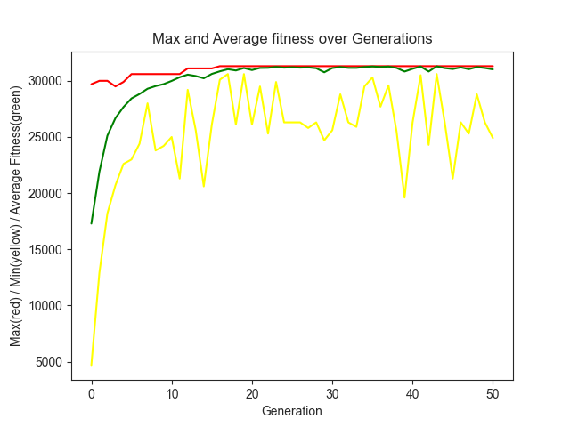
Boy School Backpack
max
✚
Backpack max. weight: 3 kg
average
✚
N of elements: 24
min
✚
Max generation: 50
✚
Population size: 50
✚
Crossover: 90%
✚
Mutation: 10%

Slide 8
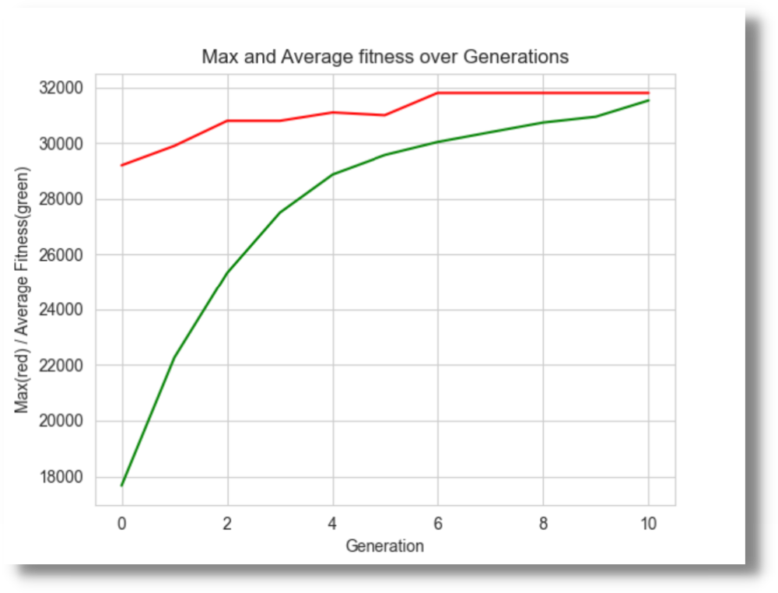
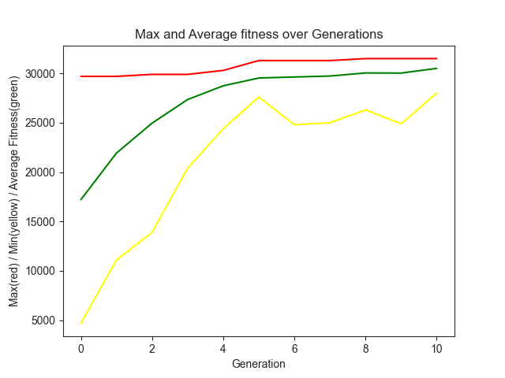
Boy School Backpack
max
✚
Backpack max. weight: 3 kg
average
✚
N of elements: 24
min
✚
Max generation: 10
✚
Population size: 70
✚
Crossover: 90%
✚
Mutation: 5%

Slide 9
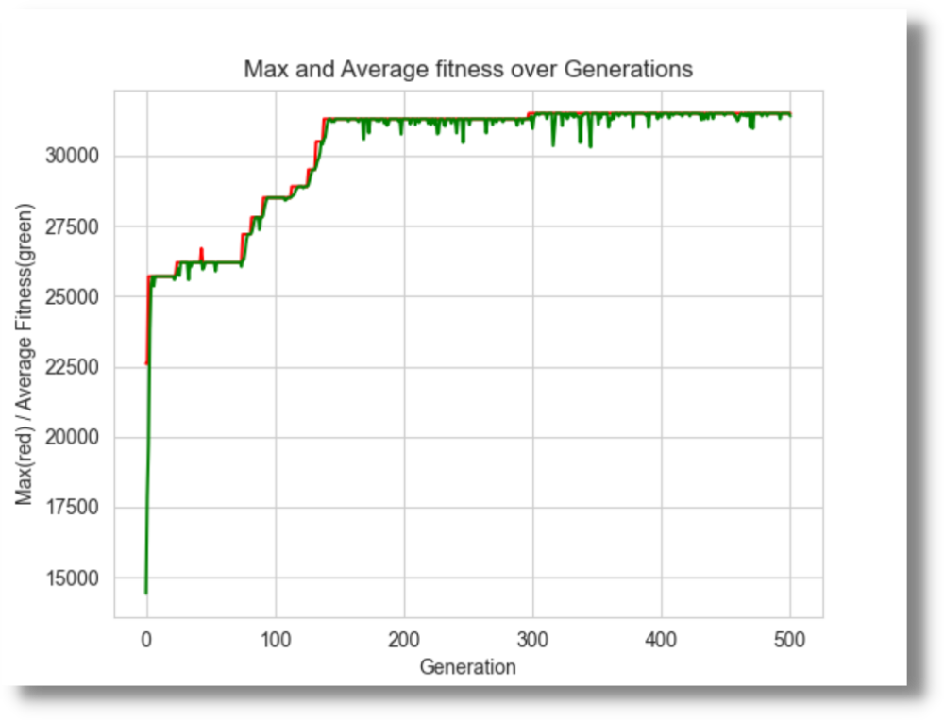
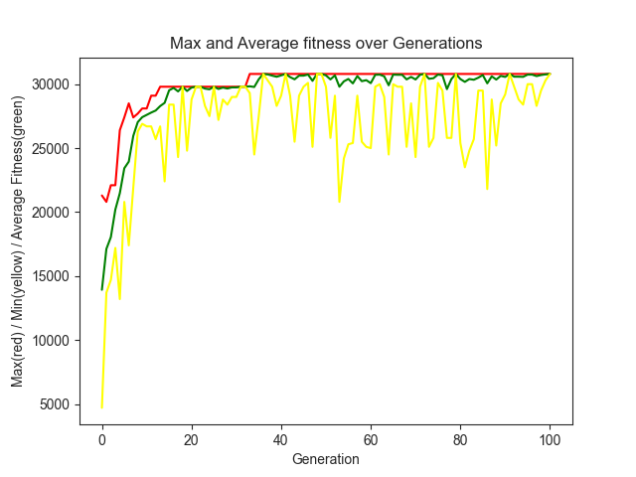
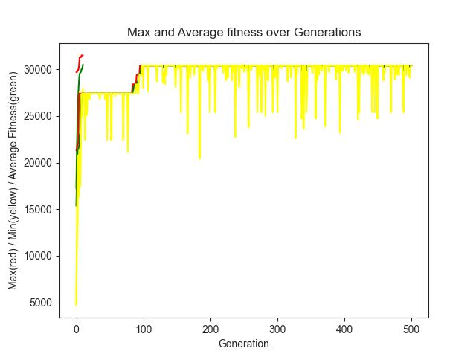
Boy School Backpack
max
✚
Backpack max. weight: 3 kg
average
✚
N of elements: 24
min
✚
Max generation: 100
✚
Population size: 15
✚
Crossover: 90%
✚
Mutation: 15%

Slide 10
Results
1ST TEST
2ND TEST
3RD TEST
fitness
fitness
fitness
31300
31500
30800
weight
weight
weight
3000 g / 3000 g
3000 g / 3000 g
3000 g / 3000 g

Slide 11
End
Thank you
Do you have any questions?

